Slide 1
Standards are Necessary, but not Sufficient, for Software Excellence
SOFTWARE QUALITY CONFERENCE
PACIFIC NW
[David N. Card] [Presented DATE]
PNSQC ™

Slide 2
Key points and Overview of Content
SOFTWARE QUALITY CONFERENCE
PACIFIC NW
Process Reference Models/Standards
Software Excellence Model
Necessary and Sufficient
Reasons for Ineffective Implementations
Measurement Indicator Model
In-Process Audits
PNSQC ™

Slide 3
Process Reference Models/Standards
SOFTWARE QUALITY CONFERENCE
PACIFIC NW
Examples: CMMI, ISO/IEC 9126
Necessary
Substantial evidence that effective implementations improve quality/reduce defects
Not sufficient
Only address static properties, not dynamic properties
Implementations are often deficient
PNSQC ™

Slide 4
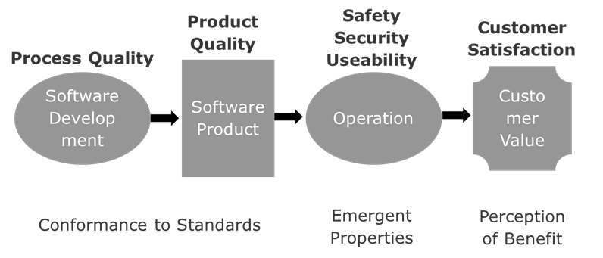
Models and standards are not Sufficient

Slide 5
Contributors to Deficient Implementations
SOFTWARE QUALITY CONFERENCE
PACIFIC NW
Changes of personnel
Incomplete understanding of process requirements
Overconfidence – don’t need to follow process
Lack of regular feedback on performance
PNSQC ™

Slide 6
Measurement Indicator Model
SOFTWARE QUALITY CONFERENCE
PACIFIC NW
Measured value
Decistion Criteria – statistics, heuristics
Indication of Need for Investigation
Expected
Value – plan, history, target
Currently, there are no absolute measurements for software engineering
PNSQC ™

Slide 7
What to measure?
SOFTWARE QUALITY CONFERENCE
PACIFIC NW
Effort and progress are standard
Quality is often overlooked until too late
Defects can be identified through the life cycle – the basic principle of Lean: Do it right the first time!
PNSQC ™

Slide 8
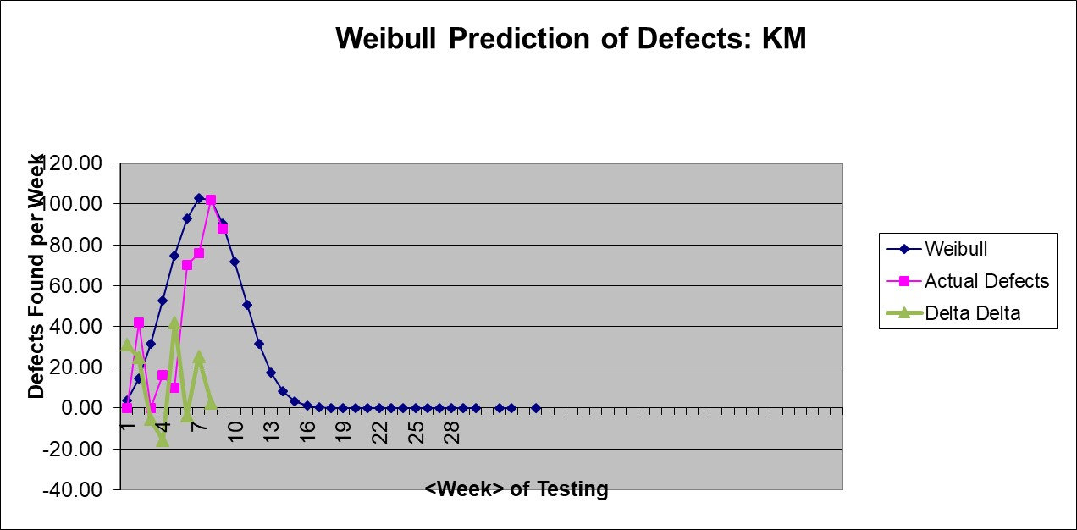
Weibull Model to Evaluate Defect Profile
SOFTWARE QUALITY CONFERENCE
PACIFIC NW
Defect profile demonstrated to follow Weibull model
Best fit based on heuristics
Indicates that progress is unusual
PNSQC ™

Slide 9
In-Process Audits
SOFTWARE QUALITY CONFERENCE
PACIFIC NW
Compliance to standards often evaluated prior to project start (e.g., source selection)
Departures from intended process not recognized until activity is complete – need to make-up documentation and work (e.g., post mortem)
Audits should be conducted during the execution of critical activities (i.e., in-process)
PNSQC ™

Slide 10
Closing Reference Slide
SOFTWARE QUALITY CONFERENCE
PACIFIC NW
University Federal do Rio de Janeiro, Software Engineering Research Group
card@computer.org
F.McGarry, D. Card, et al., Practical Software Measurement, Addison Wesley, 2002
PNSQC ™

